Slide 1
Cutting My Hair
Sample posted to personal website, July 2018

Slide 2
Background
I just gave myself a haircut on July 17
I’ve been cutting my own hair for the last 20 years
I generally give myself a haircut every two to four weeks
I’ve developed somewhat of a routine for cutting my hair

Slide 3
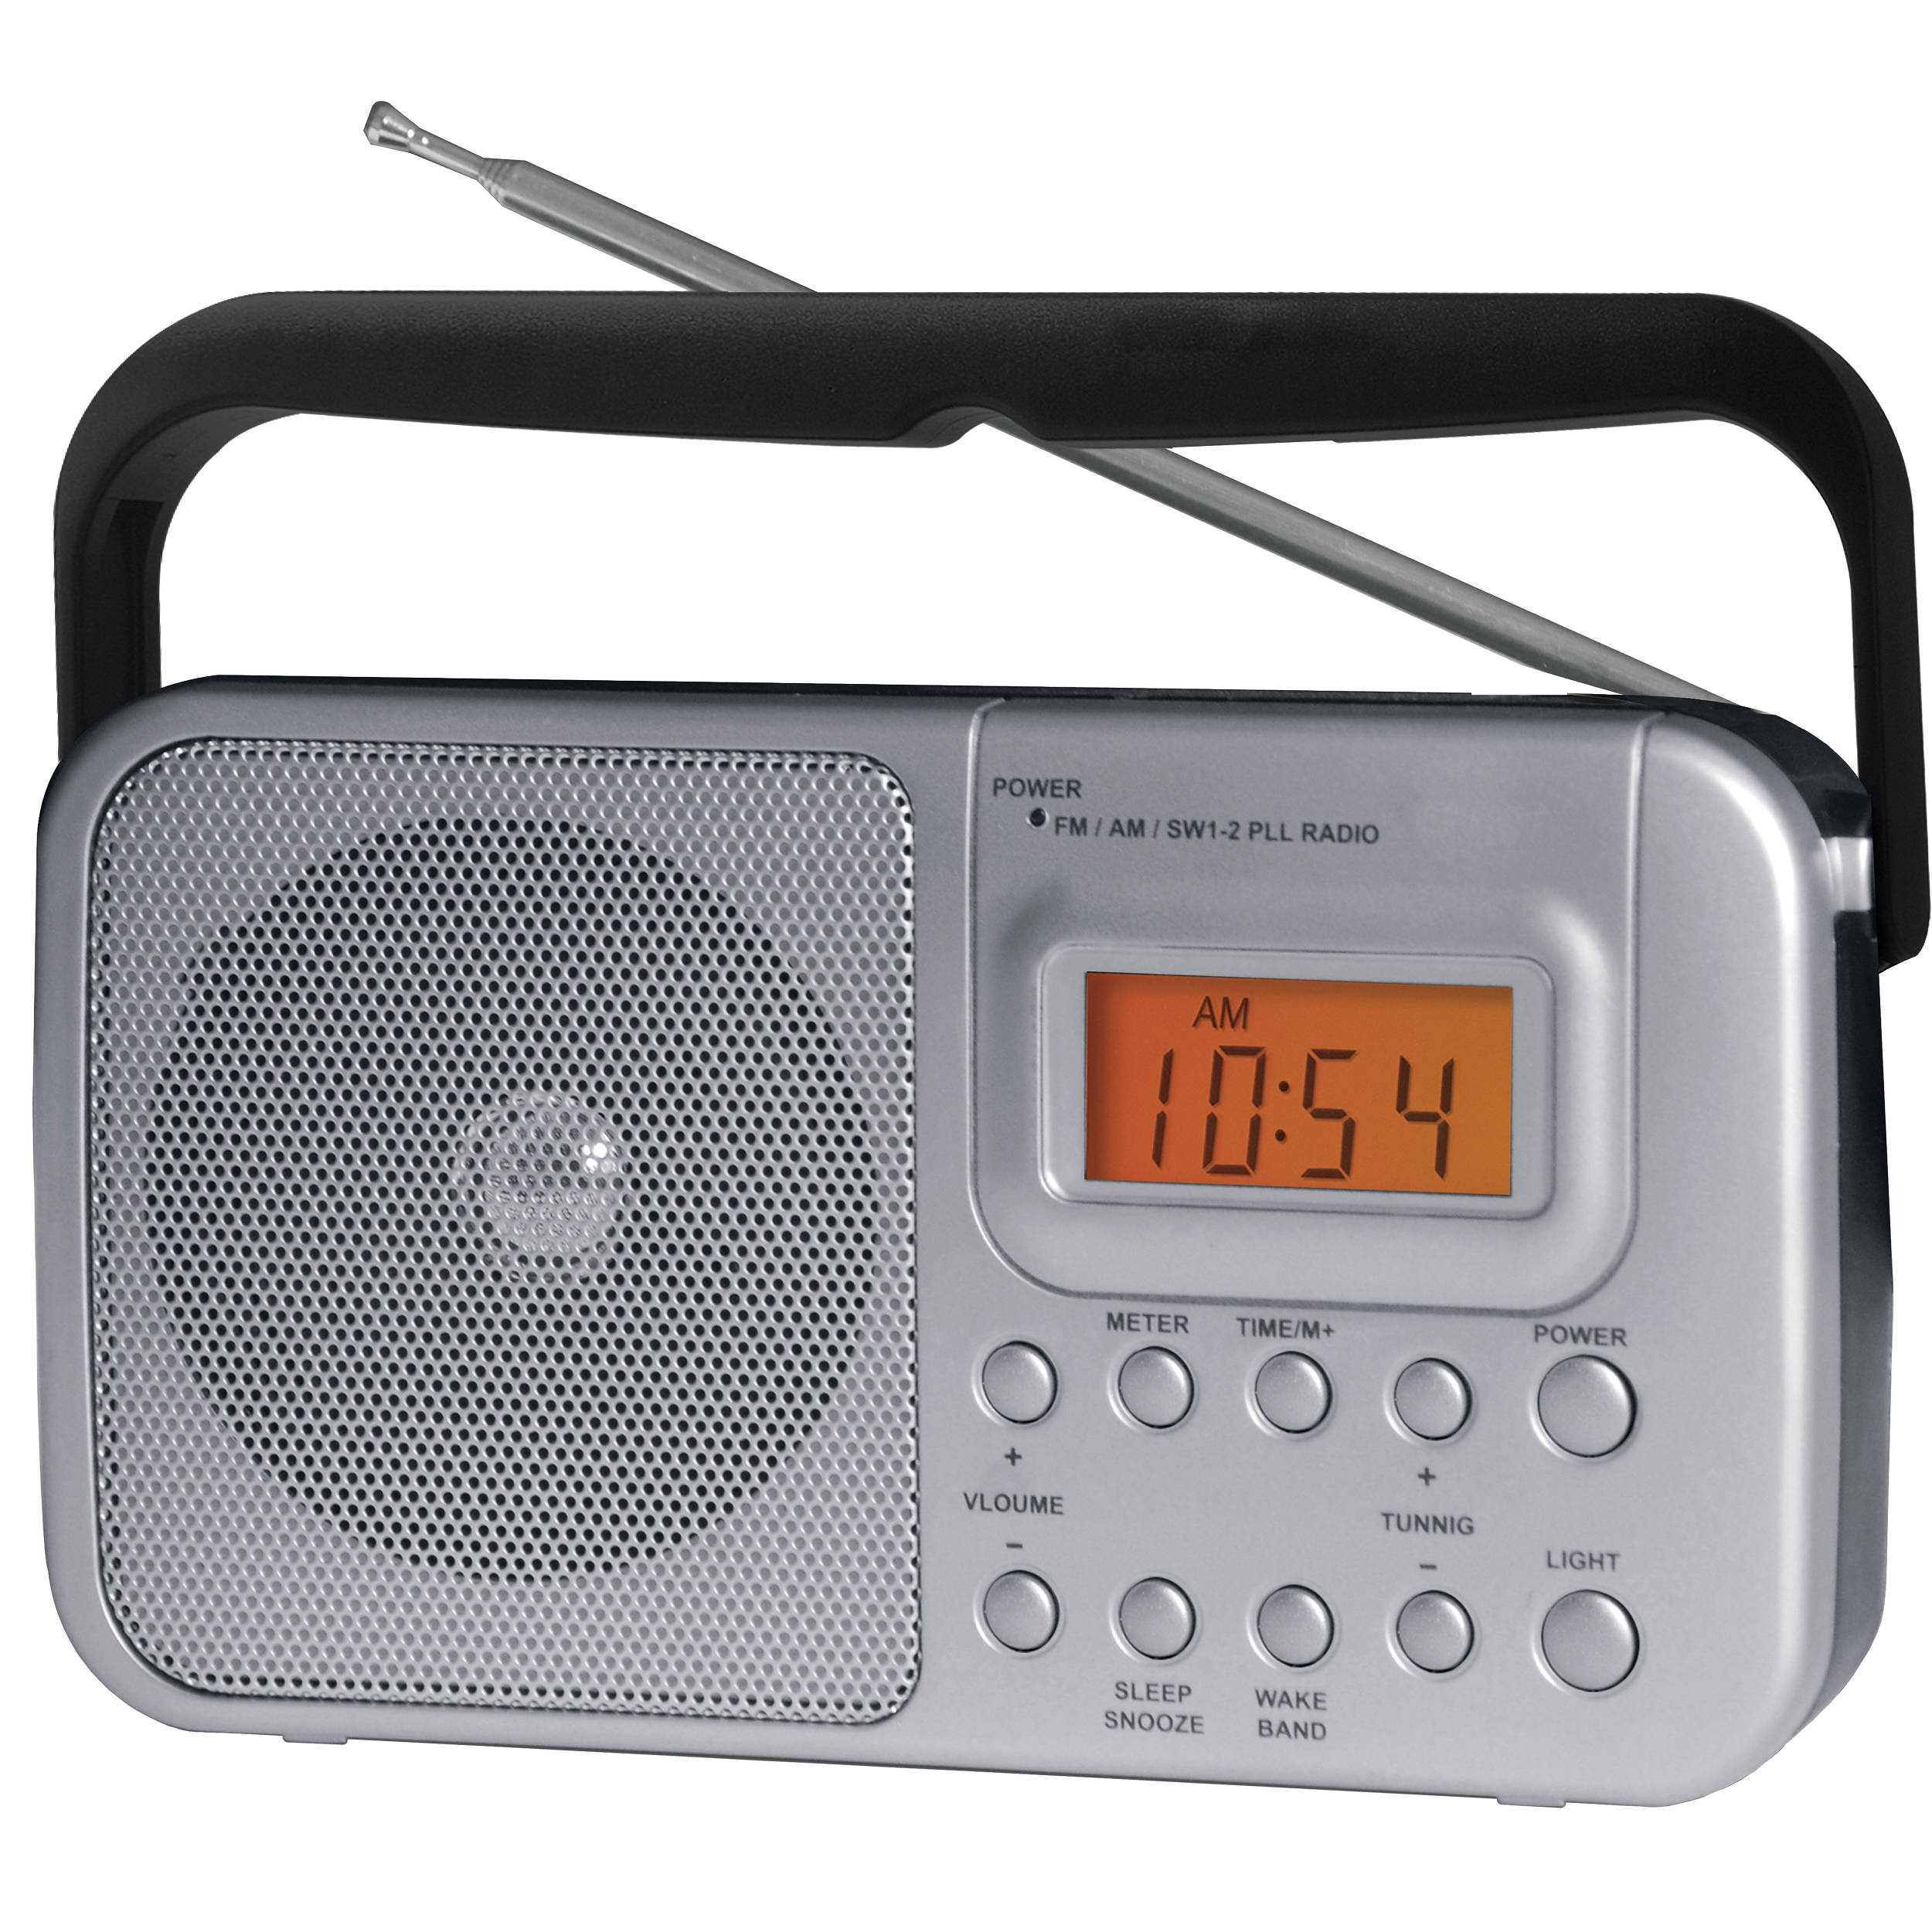
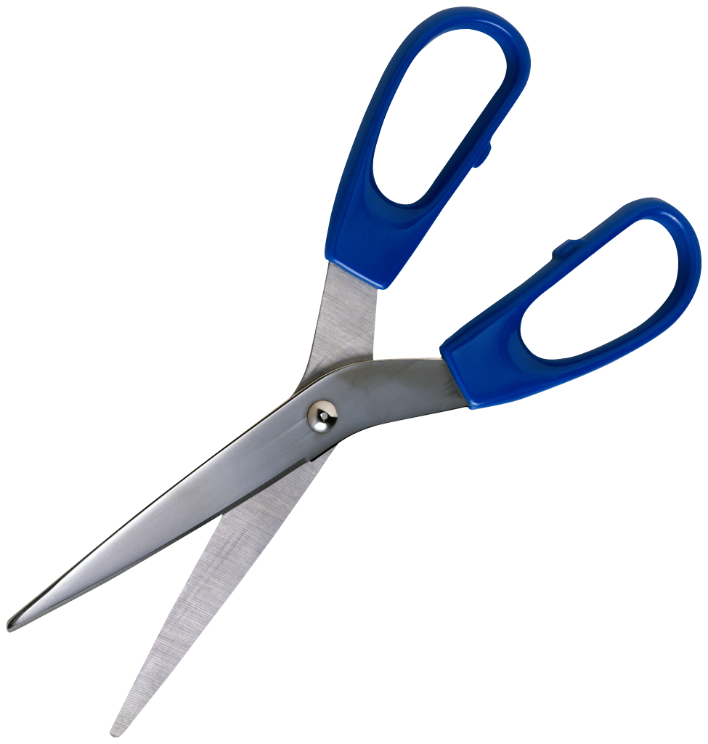
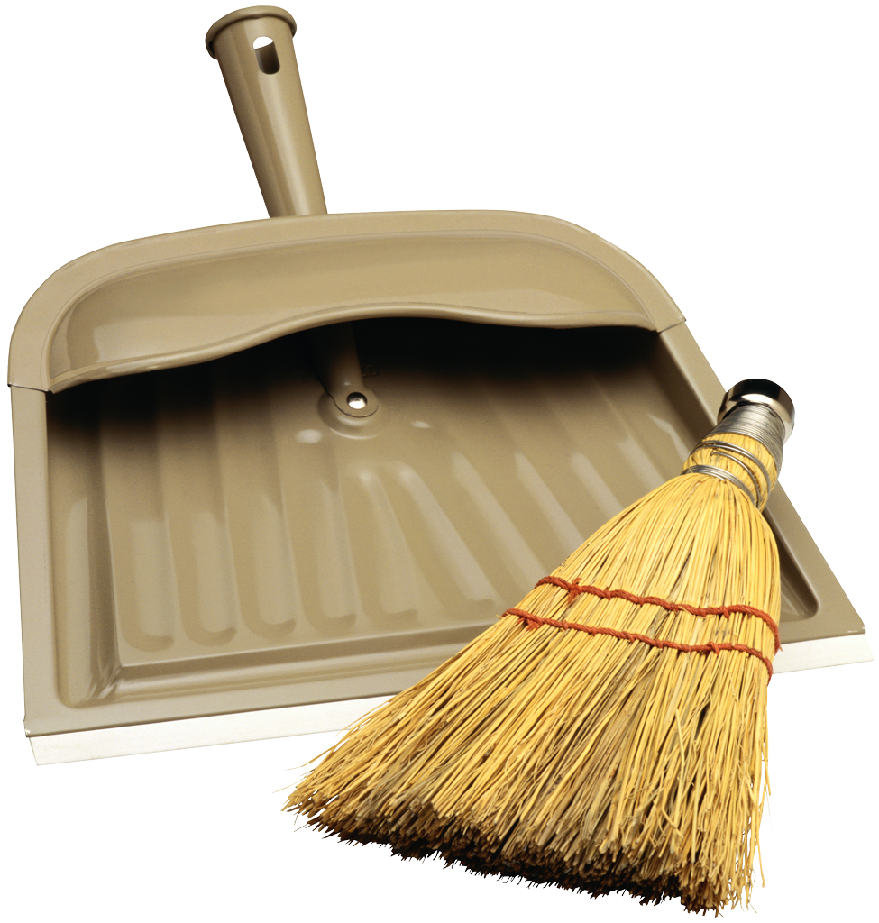
The Haircutting Process
Step 1:
Preparation
Step 2:
The haircut
Step 3:
Cleanup

Slide 4
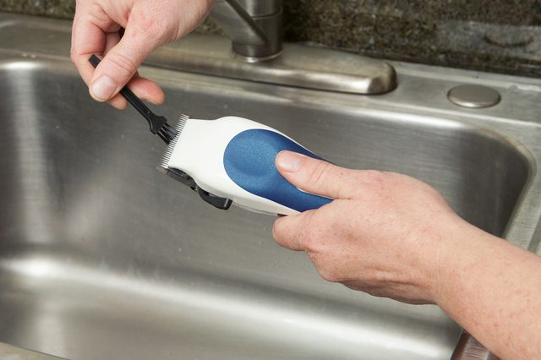
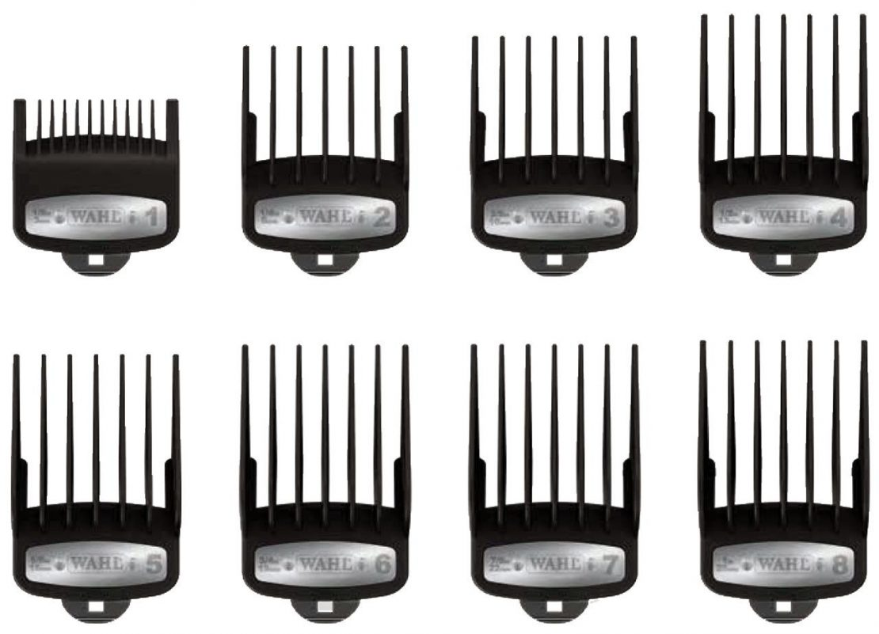
Step 1: Preparation
Turn radio on
Clean clippers
Choose guards to use

Slide 5
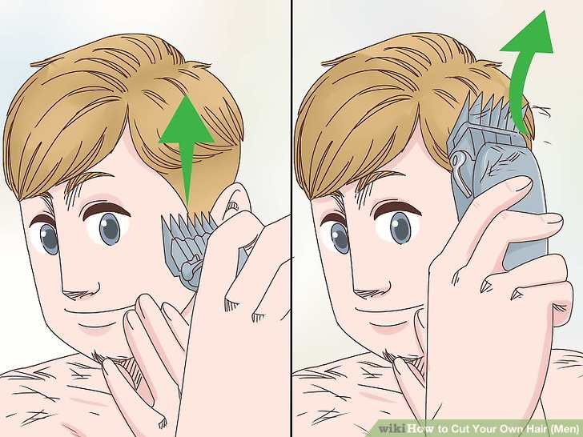
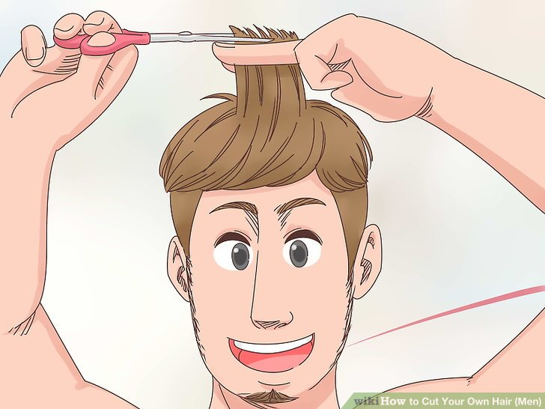
Step 2: The Haircut
Cut sides with clippers, using a guard (size 3 to 8)
Trim top with scissors
Cut sides closer with clippers, using a guard (size 1), and blend layers
Images from WikiHow [https://www.wikihow.com/Cut-Your-Own-Hair-(Men)] and are republished under Creative Commons license 3.0 (http://creativecommons.org/licenses/by-nc-sa/3.0/)

Slide 6
Step 3: Cleanup
Brush hair off
Clean hair from sink with sponge
Vacuum hair off floor
Clean and oil clippers

Slide 7
Division of Time
Preparation: approximately 11%, on average, of total time
Actual haircut: approximately 68% of total time
Cleanup: approximately 21% of total time

Slide 8
Number of Haircuts Each Month Thus Far in 2018
I generally cut my hair once or twice every month

Slide 9
Haircuts in Spring 2018
Below is a sample of data on four of my haircuts this spring
Haircut number | Weight of hair cut (oz.) | Time spent, including preparation and cleanup (min.)
1 | 5 | 51
2 | 4 | 45
3 | 3 | 63
4 | 8 | 72
Data made up

Slide 10
Conclusion
I’ve developed a routine for cutting my hair
I enjoy listening to music while I cut my hair
Cleaning up after is important

Slide 11
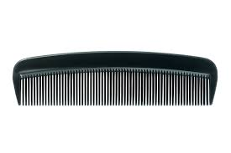
Acknowledgments
Thank you to my brother for cutting my hair when I was younger and for helping me figure out how to cut my own hair

