Slide 1
My First Website: A Presentation

Slide 2
Background
I have an interview for a technical writer/editor position on July 3, and I created a website primarily to demonstrate my comfort with technology.
This presentation outlines the steps I took and serves as a sample of my writing.

Slide 3
Starting Out: The Name
I spent approximately 30 minutes thinking of an appropriate URL. What would convey that I put thought into the project but that I wasn’t taking myself too seriously?
My first choice, workbysteve.com, was taken by a repairman. I decided on sitebysteve.com to demonstrate this was an exercise principally about the creation of a website.

Slide 4
Moving Forward: The Process
I Googled “how to create a website” and read different recommendations. I also searched for YouTube videos, considering the number of views might give an indication of the video’s legitimacy; also, this would allow me to navigate through instructional pages while listening to the videos.
I searched for recommendations on hosting platforms and decided on one that received positive reviews from several sources.

Slide 5
Adding Features: Working with WordPress
After following the prompts from the hosting platform, I began to build my site through WordPress.
I considered what content to display as well as the design of the site when installing the different features.

Slide 6
Feature Highlight: Documentation
The site is a good platform to present additional samples of my writing.
I’ll document just everyday events, given the time constraints, and post them on the site.
I’d like to show the versatility in my writing and my ability to use different applications as well as give a broader picture of who I am.

Slide 7
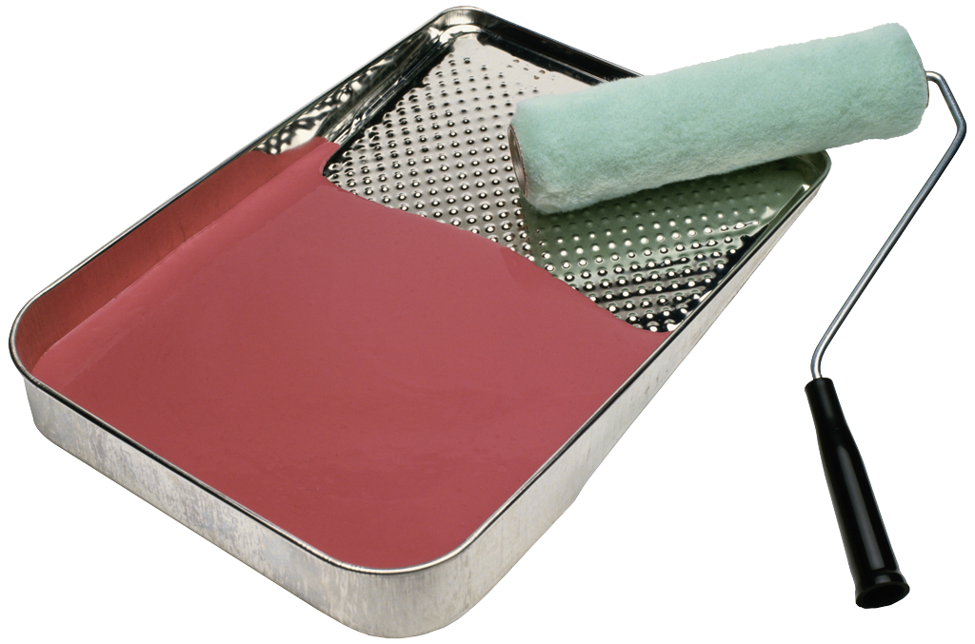
Tweaking the Design
I tried out different layouts for the site and decided on a design. Among the considerations were
Ease of use for the public
Representation of my tastes
Availability of features I wanted to include

Slide 8
Current Status of the Site (as of June 27, 2018)
I’ve established the basics—namely, the design and menu. For the homepage, I just posted a photo from my trip to Singapore a few years ago.
I’ll be adding writing samples as I finish them.

Slide 9
Defining the Deliverables (as of June 27, 2018)
Continually develop the design of the site
Consider and complete examples of short-form documentation
Improve upon features for visitors to access these samples
Email L.H. the link to the site

